Slide 1
CS F342
COMPUTER ARCHITECTURE

Slide 2
Instruction Set
§2.1 Introduction
The repertoire of instructions of a computer
Different computers have different instruction sets
But with many aspects in common
Early computers had very simple instruction sets
Simplified implementation
Many modern computers also have simple instruction sets

Slide 3
The MIPS Instruction Set
Used as the example throughout the course
Stanford MIPS commercialized by MIPS Technologies (www.mips.com)
Large share of embedded core market
Applications in consumer electronics, network/storage equipment, cameras, printers, …
Typical of many modern ISAs
See MIPS Reference Data tear-out card, and Appendixes B and E

Slide 4
Arithmetic Operations
Add and subtract, three operands
Two sources and one destination
add a, b, c # a gets b + c
All arithmetic operations have this form
Design Principle 1: Simplicity favours regularity (keeping all instructions a single size, always requiring three register operands in arithmetic instructions, and keeping the register fields in the same place in each instruction format.)
Regularity makes implementation simpler
Simplicity enables higher performance at lower cost
§2.2 Operations of the Computer Hardware

Slide 5
Arithmetic Example
C code:
f = (g + h) - (i + j);
Compiled MIPS code:
add t0, g, h # temp t0 = g + h add t1, i, j # temp t1 = i + j sub f, t0, t1 # f = t0 - t1

Slide 6
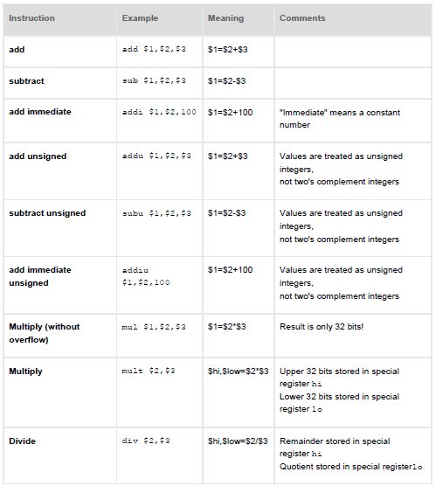
Arithmetic instructions

Slide 7
Arithmetic instructions

Slide 8
Register Operands
Arithmetic instructions use register operands
MIPS has a 32 × 32-bit register file
Use for frequently accessed data
Numbered 0 to 31
32-bit data called a “word”
Assembler names
$t0, $t1, …, $t9 for temporary values
$s0, $s1, …, $s7 for saved variables
Design Principle 2: Smaller is faster
c.f. main memory: millions of locations
§2.3 Operands of the Computer Hardware

Slide 9
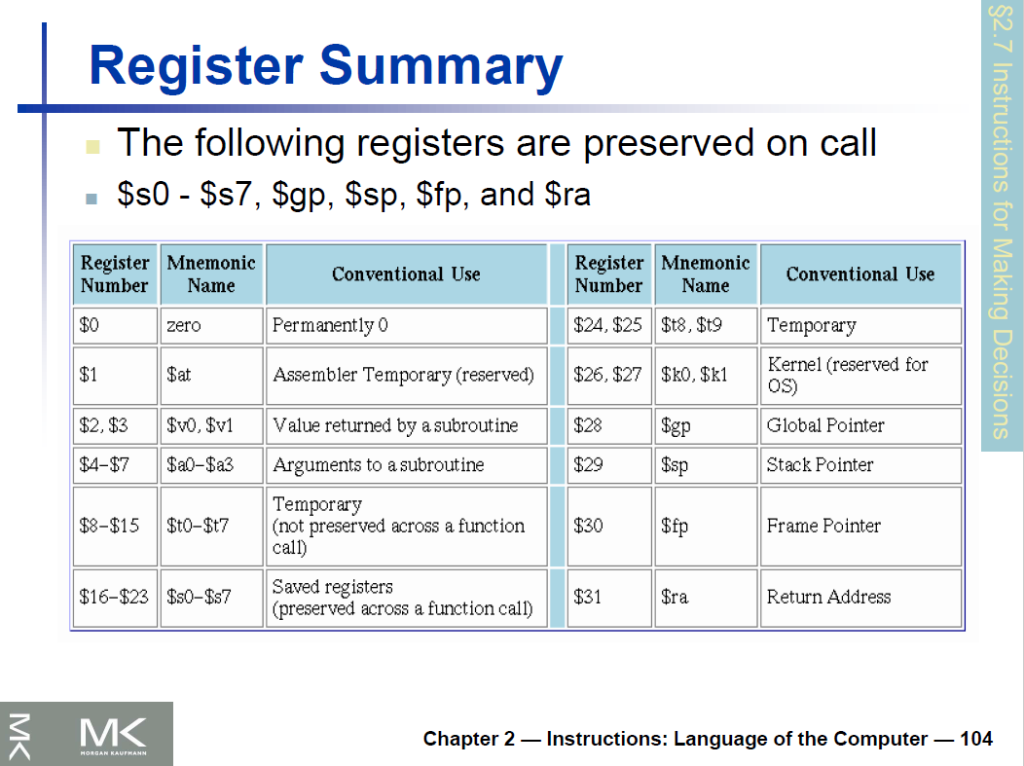

Slide 10
Register Operand Example
C code:
f = (g + h) - (i + j);
f, …, j in $s0, …, $s4
Compiled MIPS code:
add $t0, $s1, $s2 add $t1, $s3, $s4 sub $s0, $t0, $t1

Slide 11
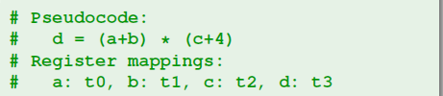

Example 1

Slide 12
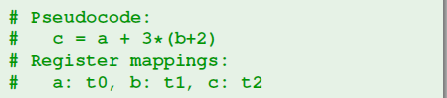
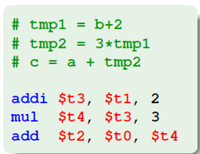
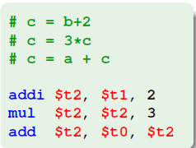
Example 2

Slide 13
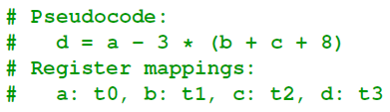
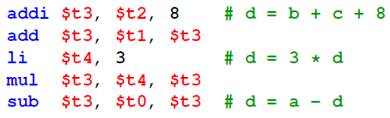
Example 3

Slide 14
Memory Operands
Main memory used for composite data
Arrays, structures, dynamic data
To apply arithmetic operations
Load values from memory into registers
Store result from register to memory
Memory is byte addressed
Each address identifies an 8-bit byte
Words are aligned in memory
Address must be a multiple of 4
MIPS is Big Endian or Little Endian
Most-significant byte at least address of a word
c.f. Little Endian: least-significant byte at least address

Slide 15
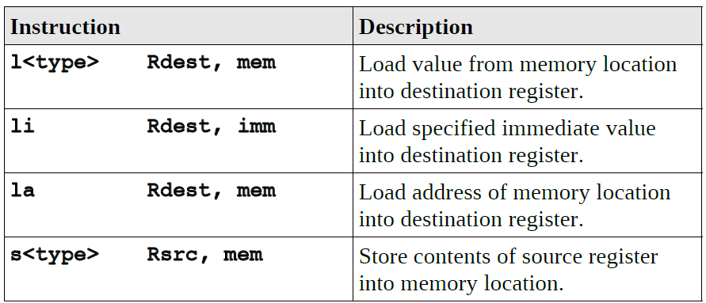
Load/Store instructions
<type> b:byte(8bits), h:half word(16 bits), w:word(32bits)
char c;
c = 'A’;
c: .byte 0
li $t0, 'A'
sw $t0, x
int x = 20;
int y;
y = x;
x: .word 20
lw $t0, x
sw $t0, y
int x;
x = 20;
x: .word 0
li $t0, 20
sw $t0, x

Slide 16
Memory Operand Example 1
C code:
g = h + A[8];
g in $s1, h in $s2, base address of A in $s3
Compiled MIPS code:
Index 8 requires offset of 32
4 bytes per word
lw $t0, 32($s3) # load word add $s1, $s2, $t0
offset
base register

Slide 17
Memory Operand Example 2
C code:
A[12] = h + A[8];
h in $s2, base address of A in $s3
Compiled MIPS code:
Index 8 requires offset of 32
lw $t0, 32($s3) # load word add $t0, $s2,$t0 sw $t0, 48($s3) # store word

Slide 18
Registers vs. Memory
Registers are faster to access than memory
Operating on memory data requires loads and stores
More instructions to be executed
Compiler must use registers for variables as much as possible
Only spill to memory for less frequently used variables
Register optimization is important!

Slide 19
Immediate Operands
Constant data specified in an instruction
addi $s3, $s3, 4
No subtract immediate instruction
Just use a negative constant
addi $s2, $s1, -1
Design Principle 3: Make the common case fast
Small constants are common
Immediate operand avoids a load instruction

Slide 20
The Constant Zero
MIPS register 0 ($zero) is the constant 0
Cannot be overwritten
Useful for common operations
E.g., move between registers
add $t2, $s1, $zero

Slide 21
Representing Instructions
Instructions are encoded in binary
Called machine code
MIPS instructions
Encoded as 32-bit instruction words
Small number of formats encoding operation code (opcode), register numbers, …
Regularity!
Register numbers
$t0 – $t7 are reg’s 8 – 15
$t8 – $t9 are reg’s 24 – 25
$s0 – $s7 are reg’s 16 – 23
§2.5 Representing Instructions in the Computer

Slide 22
MIPS R-format Instructions
op
rs
rt
rd
shamt
funct
6 bits
5 bits
5 bits
5 bits
5 bits
6 bits
Instruction fields
op: operation code (opcode)
rs: first source register number
rt: second source register number
rd: destination register number
shamt: shift amount (00000 for now)
funct: function code (extends opcode)

Slide 23
R-format Example
op
rs
rt
rd
shamt
funct
6 bits
5 bits
5 bits
5 bits
5 bits
6 bits
add $t0, $s1, $s2
op
$s1
$s2
$t0
0
add
0
17
18
8
0
32
000000
10001
10010
01000
00000
100000
HEX representation:
00000010001100100100000000100000₂ = 02324020₁₆

Slide 24
Hexadecimal
Base 16
Compact representation of bit strings
4 bits per hex digit
0 | 0000 | 4 | 0100 | 8 | 1000 | c | 1100
1 | 0001 | 5 | 0101 | 9 | 1001 | d | 1101
2 | 0010 | 6 | 0110 | a | 1010 | e | 1110
3 | 0011 | 7 | 0111 | b | 1011 | f | 1111
What is the binary representation of:
eca8 6420
1110 1100 1010 1000 0110 0100 0010 0000

Slide 25
MIPS I-format Instructions
op
rs
rt
constant or address
6 bits
5 bits
5 bits
16 bits
Immediate arithmetic and load/store instructions
rt: destination or source register number
Constant: –2¹⁵ to +2¹⁵ – 1
Address: offset added to base address in rs
Design Principle 4: Good design demands good compromises
Different formats complicate decoding, but allow 32-bit instructions uniformly
Keep formats as similar as possible

Slide 26
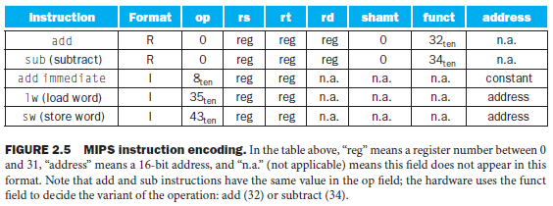
MIPS instruction encoding

Slide 27
Load instruction example
19 (for $s3) is placed in the rs field
8 (for $t0) is placed in the rt field
32 is placed in the address field

Slide 28
Translating MIPS Assembly Language into Machine Language
A[300] = h + A[300]; A-$t1 & h-$s2

Slide 29

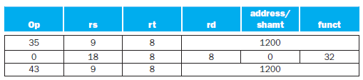

Machine language instructions using decimal numbers
Binary equivalent to the decimal form

Slide 30
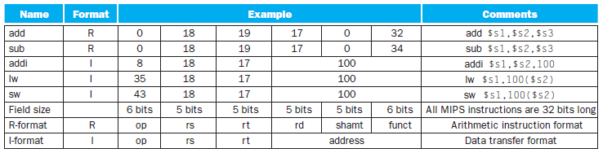
MIPS machine language?

Slide 31
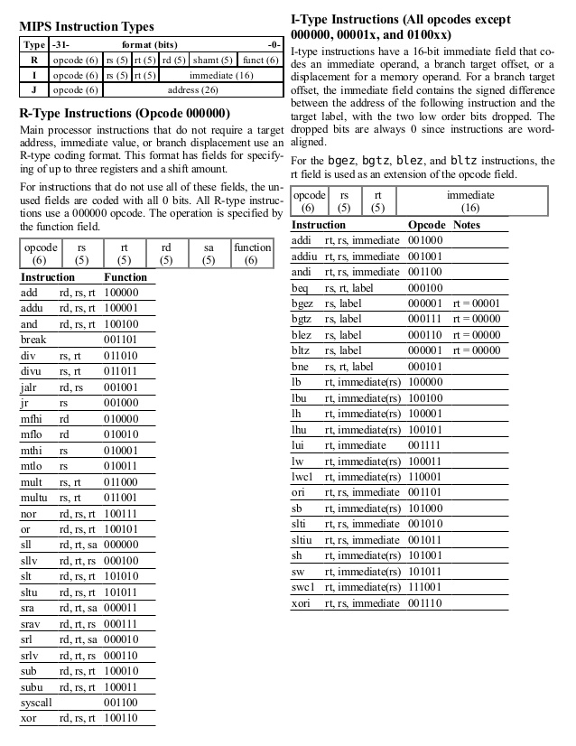
$t0 – $t7 are reg’s 8 – 15
$t8 – $t9 are reg’s 24 – 25
$s0 – $s7 are reg’s 16 – 23

Slide 32
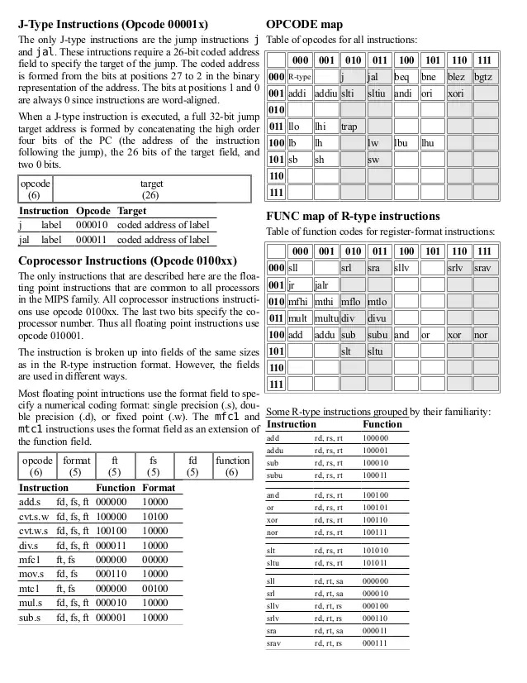

Slide 33
MIPS machine language

Slide 34
Unsigned Binary Integers
Given an n-bit number
§2.4 Signed and Unsigned Numbers
Range: 0 to +2^{n} – 1
Example
0000 0000 0000 0000 0000 0000 0000 1011₂ = 0 + … + 1×2³ + 0×2² +1×2¹ +1×2⁰ = 0 + … + 8 + 0 + 2 + 1 = 11₁₀
Using 32 bits
0 to +4,294,967,295

Slide 35
2s-Complement Signed Integers
Given an n-bit number
Range: –2^{n – 1} to +2^{n – 1} – 1
Example
1111 1111 1111 1111 1111 1111 1111 1100₂ = –1×2³¹ + 1×2³⁰ + … + 1×2² +0×2¹ +0×2⁰ = –2,147,483,648 + 2,147,483,644 = –4₁₀
Using 32 bits
–2,147,483,648 to +2,147,483,647

Slide 36
2s-Complement Signed Integers
Bit 31 is sign bit
1 for negative numbers
0 for non-negative numbers
–(–2^{n – 1}) can’t be represented
Non-negative numbers have the same unsigned and 2s-complement representation
Some specific numbers
0: 0000 0000 … 0000
–1: 1111 1111 … 1111
Most-negative: 1000 0000 … 0000
Most-positive: 0111 1111 … 1111

Slide 37
Signed Negation
Complement and add 1
Complement means 1 → 0, 0 → 1
Example: negate +2
+2 = 0000 0000 … 0010₂
–2 = 1111 1111 … 1101₂ + 1 = 1111 1111 … 1110₂

Slide 38
Sign Extension
Representing a number using more bits
Preserve the numeric value
In MIPS instruction set
addi: extend immediate value
lb, lh: extend loaded byte/halfword
beq, bne: extend the displacement
Replicate the sign bit to the left
c.f. unsigned values: extend with 0s
Examples: 8-bit to 16-bit
+2: 0000 0010 => 0000 0000 0000 0010
–2: 1111 1110 => 1111 1111 1111 1110

Slide 39
Logical Operations
Instructions for bitwise manipulation
§2.6 Logical Operations
Operation | C | Java | MIPS
Shift left | << | << | sll
Shift right | >> | >>> | Srl
Bitwise AND | & | & | and, andi
Bitwise OR | | | | | or, ori
Bitwise NOT | ~ | ~ | Nor
Useful for extracting and inserting groups of bits in a word

Slide 40
Shift Operations
op
rs
rt
rd
shamt
funct
6 bits
5 bits
5 bits
5 bits
5 bits
6 bits
shamt: how many positions to shift
Shift left logical
Shift left and fill with 0 bits
sll by i bits multiplies by 2^{i}
Shift right logical
Shift right and fill with 0 bits
srl by i bits divides by 2^{i} (unsigned only)

Slide 41
AND Operations
Useful to mask bits in a word
Select some bits, clear others to 0
and $t0, $t1, $t2
$t2
0000 0000 0000 0000 0000 1101 1100 0000
$t1
0000 0000 0000 0000 0011 1100 0000 0000
$t0
0000 0000 0000 0000 0000 1100 0000 0000

Slide 42
OR Operations
Useful to include bits in a word
Set some bits to 1, leave others unchanged
or $t0, $t1, $t2
$t2
0000 0000 0000 0000 0000 1101 1100 0000
$t1
0000 0000 0000 0000 0011 1100 0000 0000
$t0
0000 0000 0000 0000 0011 1101 1100 0000

Slide 43
NOT Operations
Useful to invert bits in a word
Change 0 to 1, and 1 to 0
MIPS has NOR 3-operand instruction
a NOR b == NOT ( a OR b )
nor $t0, $t1, $zero
Register 0: always read as zero
$t1
0000 0000 0000 0000 0011 1100 0000 0000
$t0
1111 1111 1111 1111 1100 0011 1111 1111

Slide 44
Conditional Operations
Branch to a labeled instruction if a condition is true
Otherwise, continue sequentially
beq rs, rt, L1
if (rs == rt) branch to instruction labeled L1;
bne rs, rt, L1
if (rs != rt) branch to instruction labeled L1;
j L1
unconditional jump to instruction labeled L1
§2.7 Instructions for Making Decisions

Slide 45
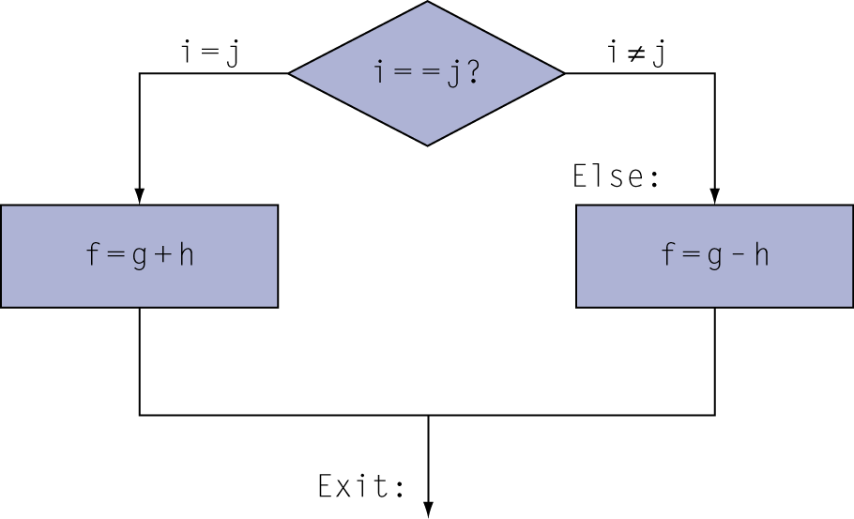
If Statements
C code:
if (i==j)
f = g + h; else
f = g - h;
f, g, … in $s0, $s1, …

Slide 46
Compiling If Statements
C code:
if (i==j) f = g+h; else f = g-h;
f, g, … in $s0, $s1, …
Compiled MIPS code:
bne $s3, $s4, Else add $s0, $s1, $s2 j Exit Else: sub $s0, $s1, $s2 Exit: …
Assembler calculates addresses

Slide 47
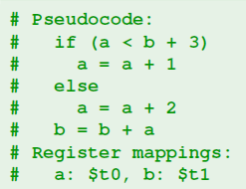
If-then-else statement

Slide 48
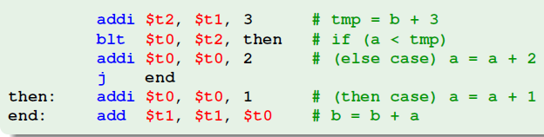

Slide 49
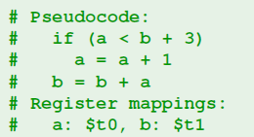
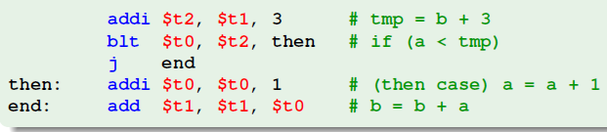
If-then

Slide 50
Compiling Loop Statements
C code:
while (save[i] == k)
i += 1;
i in $s3, k in $s5, address of save in $s6
Compiled MIPS code:
Loop: sll $t1, $s3, 2 #(mul s3*4) add $t1, $t1, $s6 lw $t0, 0($t1) #(0=zero) bne $t0, $s5, Exit addi $s3, $s3, 1 j Loop Exit: …
g = h + A[8] == lw $t0, 32($s3)

Slide 51
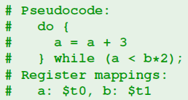
Do-while

Slide 52

Do-while

Slide 53

While loop

Slide 54
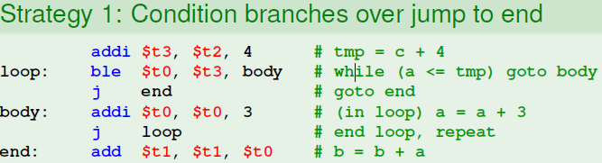
While loop

Slide 55
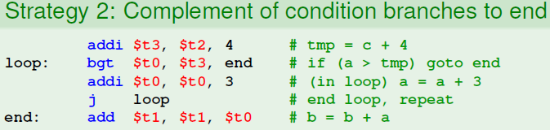
While loop

Slide 56
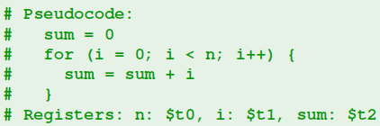
For loop

Slide 57
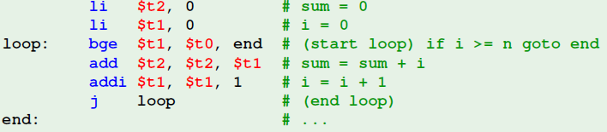
For loop

Slide 58
More Conditional Operations
Set result to 1 if a condition is true
Otherwise, set to 0
slt rd, rs, rt
if (rs < rt) rd = 1; else rd = 0;
slti rt, rs, constant
if (rs < constant) rt = 1; else rt = 0;
Use in combination with slt, bne (blt ( s1<s2))
slt $t0, $s1, $s2 # if ($s1 < $s2) beq $t0, $zero, L # branch to L

Slide 59
Branch Instruction Design
Why not blt, bge, etc?
Hardware for <, ≥, … slower than =, ≠
Combining with branch involves more work per instruction, requiring a slower clock
All instructions penalized!
beq and bne are the common case
This is a good design compromise

Slide 60
Signed vs. Unsigned
Signed comparison: slt, slti
Unsigned comparison: sltu, sltui
Example
$s0 = 1111 1111 1111 1111 1111 1111 1111 1111
$s1 = 0000 0000 0000 0000 0000 0000 0000 0001
slt $t0, $s0, $s1 # signed
–1 < +1 ⇒ $t0 = 1
sltu $t0, $s0, $s1 # unsigned
+4,294,967,295 > +1 ⇒ $t0 = 0

Slide 61
Procedure Calling
Steps required
Place parameters in registers
Transfer control to procedure
Acquire storage for procedure
Perform procedure’s operations
Place result in register for caller
Return to place of call
§2.8 Supporting Procedures in Computer Hardware

Slide 62
Register Usage
$a0 – $a3: arguments (reg’s 4 – 7)
$v0, $v1: result values (reg’s 2 and 3)
$t0 – $t9: temporaries
Can be overwritten by callee
$s0 – $s7: saved
Must be saved/restored by callee
$gp: global pointer for static data (reg 28)
$sp: stack pointer (reg 29)
$fp: frame pointer (reg 30)
$ra: return address (reg 31)

Slide 63
Procedure Call Instructions
Procedure call: jump and link
jal ProcedureLabel
Address of following instruction put in $ra
Jumps to target address
Procedure return: jump register
jr $ra
Copies $ra to program counter
Can also be used for computed jumps
e.g., for case/switch statements

Slide 64
Leaf Procedure Example
C code:
int leaf_example (int g, h, i, j) { int f; f = (g + h) - (i + j); return f; }
Arguments g, …, j in $a0, …, $a3
f in $s0 (hence, need to save $s0 on stack)
Result in $v0

Slide 65
Leaf Procedure Example
MIPS code:
leaf_example: addi $sp, $sp, -4 sw $s0, 0($sp) add $t0, $a0, $a1 add $t1, $a2, $a3 sub $s0, $t0, $t1 add $v0, $s0, $zero lw $s0, 0($sp) addi $sp, $sp, 4 jr $ra
Save $s0 on stack
Procedure body
Result
Restore $s0
Return

Slide 67
MIPS software separates 18 of the registers into two groups:
$t0–$t9: temporary registers that are not preserved by the callee (called procedure) on a procedure call
$s0–$s7: saved registers that must be preserved on a procedure call (if used, the callee saves and restores them)

Slide 68
Non-Leaf Procedures
Procedures that call other procedures
For nested call, caller needs to save on the stack:
Its return address
Any arguments and temporaries needed after the call
Restore from the stack after the call

Slide 69
Non-Leaf Procedure Example
C code:
int fact (int n) { if (n < 1) return (1); else return (n * fact(n - 1)); }
Argument n in $a0
Result in $v0

Slide 70
Non-Leaf Procedure Example
MIPS code:
fact: addi $sp, $sp, -8 # adjust stack for 2 items sw $ra, 4($sp) # save return address sw $a0, 0($sp) # save argument slti $t0, $a0, 1 # test for n < 1 beq $t0, $zero, L1 addi $v0, $zero, 1 # if so, result is 1 addi $sp, $sp, 8 # pop 2 items from stack jr $ra # and return L1: addi $a0, $a0, -1 # else decrement n jal fact # recursive call lw $a0, 0($sp) # restore original n lw $ra, 4($sp) # and return address addi $sp, $sp, 8 # pop 2 items from stack mul $v0, $a0, $v0 # multiply to get result jr $ra # and return

Slide 71
Character Data
Byte-encoded character sets
ASCII: 128 characters
95 graphic, 33 control
Latin-1: 256 characters
ASCII, +96 more graphic characters
Unicode: 32-bit character set
Used in Java, C++ wide characters, …
Most of the world’s alphabets, plus symbols
UTF-8, UTF-16: variable-length encodings
§2.9 Communicating with People

Slide 72
Byte/Halfword Operations
Could use bitwise operations
MIPS byte/halfword load/store
String processing is a common case
lb rt, offset(rs) lh rt, offset(rs)
Sign extend to 32 bits in rt
lbu rt, offset(rs) lhu rt, offset(rs)
Zero extend to 32 bits in rt
sb rt, offset(rs) sh rt, offset(rs)
Store just rightmost byte/halfword

Slide 73
String Copy Example
C code (naive):
Null-terminated string
void strcpy (char x[], char y[]) { int i; i = 0; while ((x[i]=y[i])!='\0') i += 1; }
Addresses of x, y in $a0, $a1
i in $s0

Slide 74
String Copy Example
MIPS code:
strcpy: addi $sp, $sp, -4 # adjust stack for 1 item sw $s0, 0($sp) # save $s0 add $s0, $zero, $zero # i = 0 L1: add $t1, $s0, $a1 # addr of y[i] in $t1 lbU $t2, 0($t1) # $t2 = y[i] add $t3, $s0, $a0 # addr of x[i] in $t3 sb $t2, 0($t3) # x[i] = y[i] beq $t2, $zero, L2 # exit loop if y[i] == 0 addi $s0, $s0, 1 # i = i + 1 j L1 # next iteration of loop L2: lw $s0, 0($sp) # restore saved $s0 addi $sp, $sp, 4 # pop 1 item from stack jr $ra # and return

Slide 75
32-bit Constants
Most constants are small
16-bit immediate is sufficient
For the occasional 32-bit constant
lui rt, constant
Copies 16-bit constant to left 16 bits of rt
Clears right 16 bits of rt to 0

Slide 76
What is the MIPS assembly code to load this 32-bit constant into register $s0?
0000 0000 0011 1101 0000 1001 0000 0000
In Decimal (61)-upper & (2304)-lower
lui $s0, 61
0000 0000 0111 1101 0000 0000 0000 0000
ori $s0, $s0, 2304
0000 0000 0111 1101 0000 1001 0000 0000

Slide 78
Branch Addressing
Branch instructions specify
Opcode, two registers, target address
Most branch targets are near branch
Forward or backward
op
rs
rt
constant or address
6 bits
5 bits
5 bits
16 bits
PC-relative addressing
Target address = PC + offset × 4
PC already incremented by 4 by this time

Slide 79
Jump Addressing
Jump (j and jal) targets could be anywhere in text segment
Encode full address in instruction
op
address
6 bits
26 bits
(Pseudo)Direct jump addressing
Target address = PC_{31…28} : (address × 4)

Slide 80
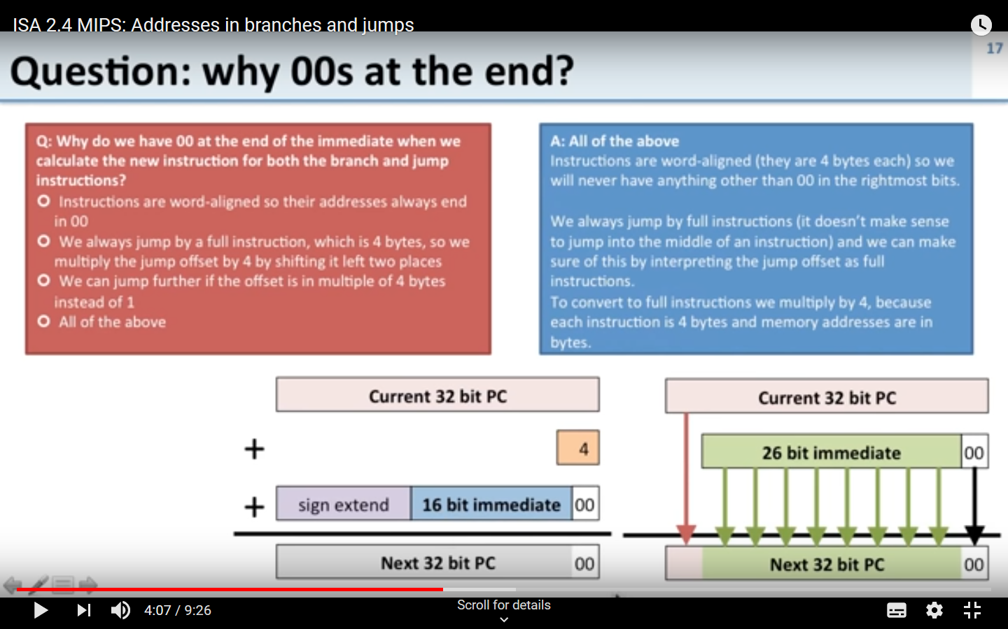

Slide 81
Target Addressing Example
Loop code from earlier example
Assume Loop at location 80000
Loop: sll $t1, $s3, 2 | 80000 | 0 | 0 | 19 | 9 | 4 | 0
add $t1, $t1, $s6 | 80004 | 0 | 9 | 22 | 9 | 0 | 32
lw $t0, 0($t1) | 80008 | 35 | 9 | 8 | 0
bne $t0, $s5, Exit | 80012 | 5 | 8 | 21 | Exit
addi $s3, $s3, 1 | 80016 | 8 | 19 | 19 | 1
j Loop | 80020 | 2 | Loop
Exit: … | 80024

Slide 82
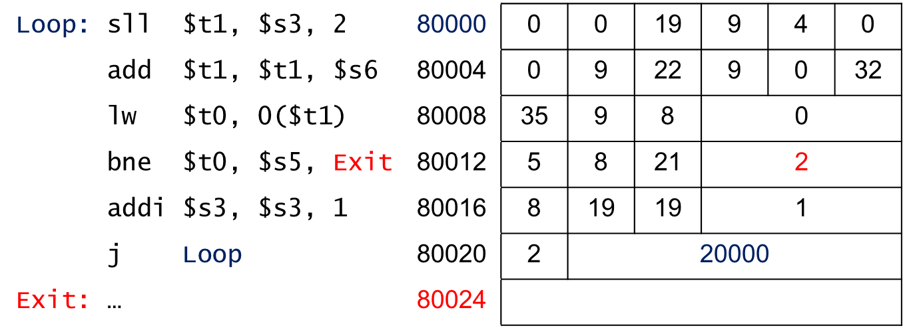

Slide 83
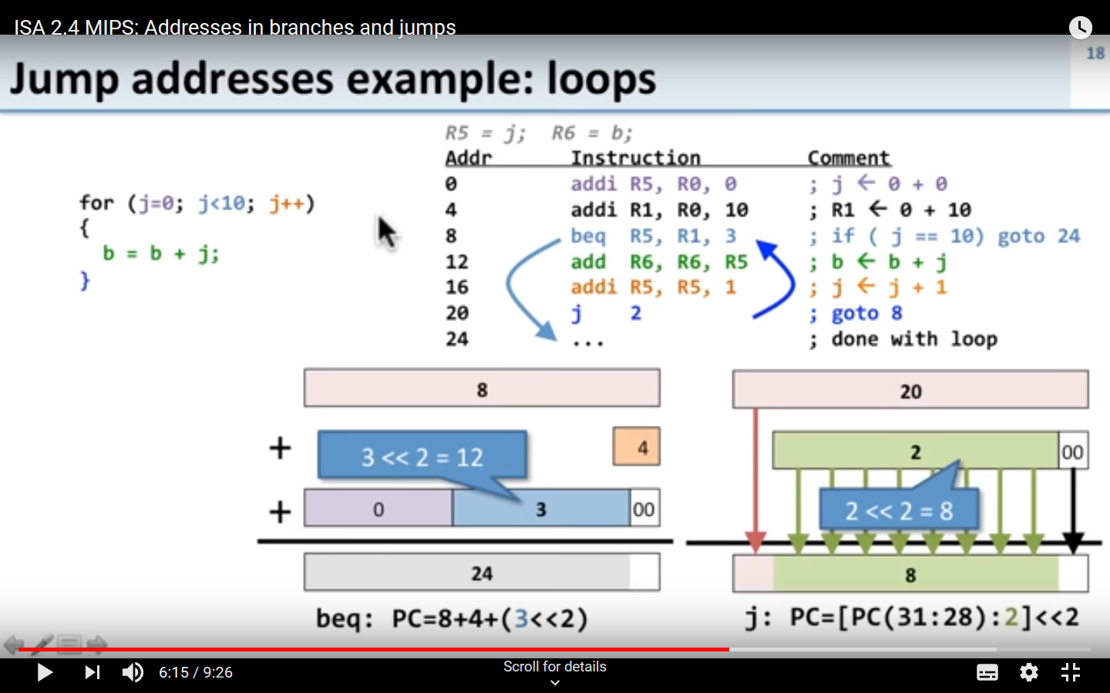

Slide 84
Branching Far Away
If branch target is too far to encode with 16-bit offset, assembler rewrites the code
Example
beq $s0,$s1, L1
↓
bne $s0,$s1, L2 j L1 L2: …

Slide 85
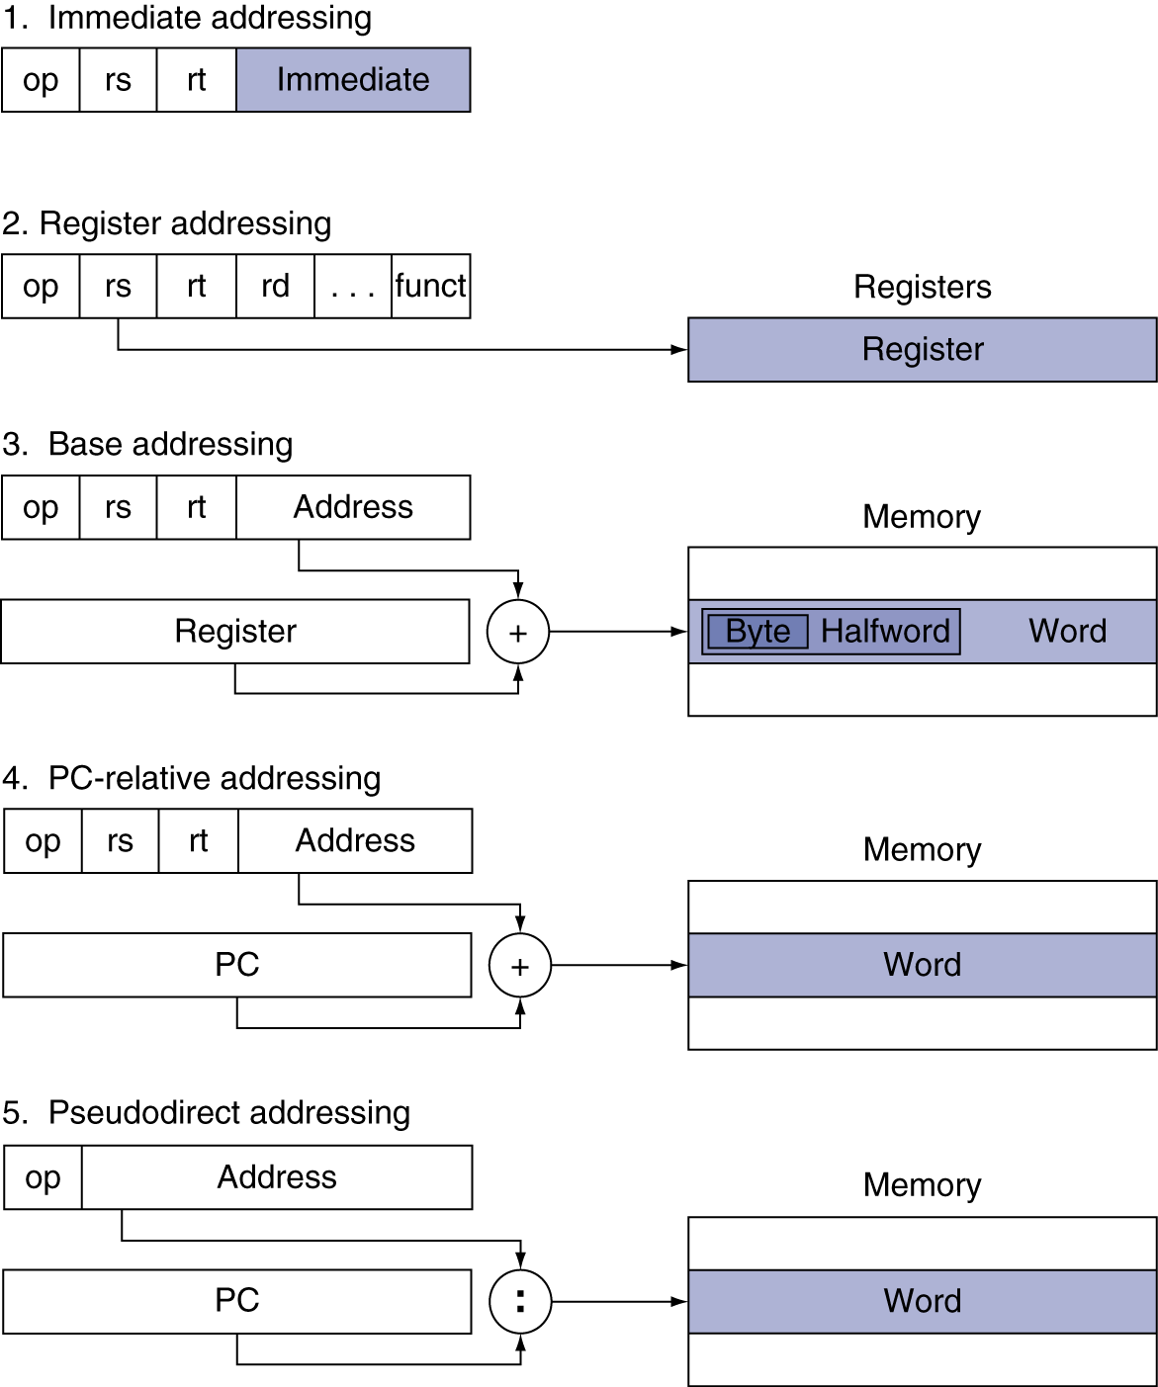
Addressing Mode Summary

Slide 86
Assembler Pseudoinstructions
Most assembler instructions represent machine instructions one-to-one
Pseudoinstructions: figments of the assembler’s imagination
move $t0, $t1 → add $t0, $zero, $t1
blt $t0, $t1, L → slt $at, $t0, $t1 bne $at, $zero, L
$at (register 1): assembler temporary

